Slide 1
EXPLORING PATHWAYS TO POLITicAL INFORMATION: facilitating Civic engagement in a diverse california community ECIL: Istanbul,Turkey, Oct. 22-25 2013
Presented by:Yolanda Blue and Elaine McCracken, University of California, Santa Barbara, USA
Notes:
This presentation will highlight some of the various tools and services information professionals provide to assist diverse communities to get involved in the civic process.

Slide 2
Greeting from Elaine McCracken
Notes:
Greetings from colleague who could not attend today. (video)

Slide 3
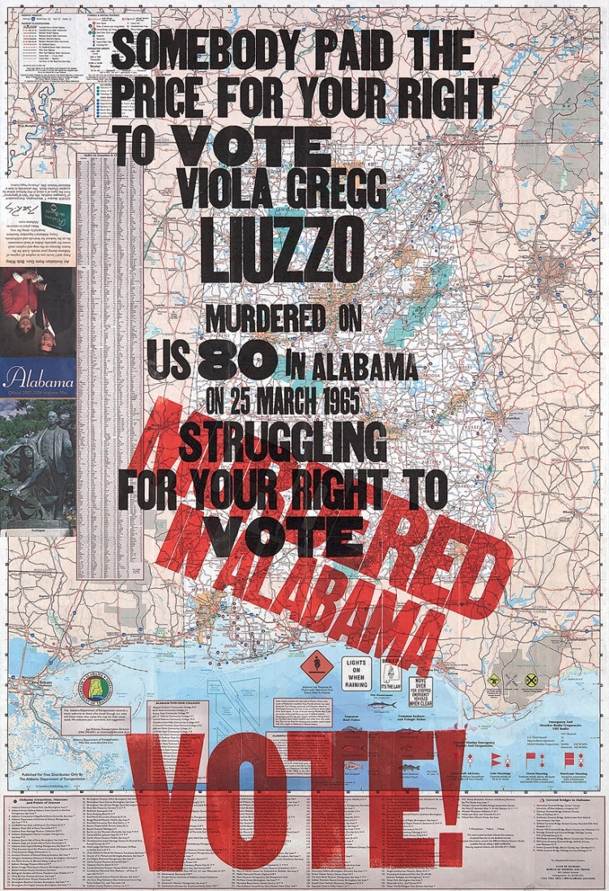
Historical Background of Voting
The right to vote in the United States is seen as a pillar of responsible citizenship and a healthy democracy.
Amos-Kennedy Poster
Official map of the State of Alabama in the USA, where acts of violence occurred during the Civil Rights Movement’s campaign to register Blacks to vote (1955-1968)
Notes:
For several years in the USA women, people of color, underrepresented populations and other communities were denied from exercising their “democratic and civic rights”. Many have fought for these rights, and in doing so, sacrificed their lives.

Slide 4
Diverse California Community
CONCERNS INCLUDE:
Housing
Homelessness
Education
Employment
Immigration
Wages
Youths
Notes:
The population in the U.S. has become increasingly multicultural and diverse. Inclusion in the civic/democratic process is crucial. Multicultural interests and concerns need to be represented by our government and society.

Slide 5
Campaign Literature
Notes:
Campaign literature is designed to convince communities how to vote, who to vote for, and who not to vote for. It is in various forms: printed election flyers, posters, brochures, newspaper articles, etc.

Slide 6
Campaign Literature
Candidate ballots address concerns and issues in Santa Barbara County.
Notes:
Having access to these various types of literature and those different issues that are promoted, help communities understand past and current issues.
Communities can observe and weigh exactly what has been said by candidates, whether they kept campaign promises, or changed positions.

Slide 7
How to make informed decisions?
WHO DO YOU BELIEVE?
WHO DO YOU BELIEVE?
Notes:
How can communities make informed decisions; how can they determine “who works for them”?
How can librarians help these communities make their decisions?

Slide 8
Politicians campaign literature available on Website, Facebook, and YouTube.
Notes:
The trend now includes not only print materials in election campaigns but also many candidates rely on websites, social networks, youtube.
Other social networks; instagrams, twitter…the list becomes endless, given the advances in technology.

Slide 9
The Future of Our Youth…
There are many issues…
Notes:
Our local community where education is considered crucial for success
and concern for the future of our youth.

Slide 10
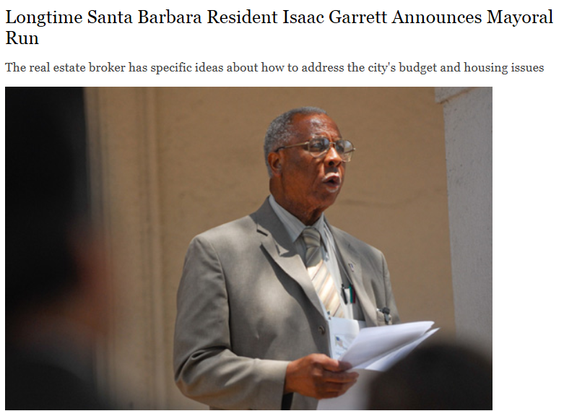
What happens when political information is no longer available?
http://www.sbre.net/isaac
History of past and current community issues disappear
Diverse voices and community memory is diminished
Access to the information is lost
Notes:
What happens when political information is no longer available? Whether print or digital, when information is lost, communities cannot make informed decisions about the positions and statements of political candidates (truthful or misleading).

Slide 11
Information Professionals Capturing and Preserving
Print, Digital, Audio, and other multimedia
Notes:
“There is no better institution to build community and strengthen civic literacy than the great and small libraries across the country… “ Barbara Clubb (2006)
How can libraries close the political information gaps and facilitate civic engagement?

Slide 12
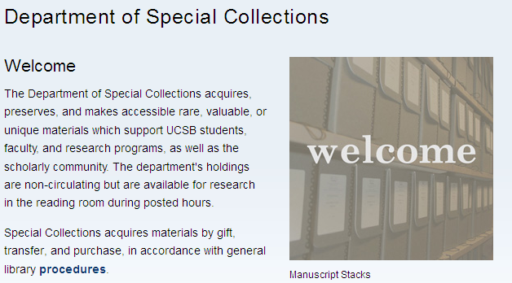
Traditional Archiving
Some tools and services include the following:
Notes:
Archiving can take place in many types of institutions, libraries, and organizations.
Archives collect, maintain, and preserve rare unique and valuable heritage materials.
Organizing and describing materials creates ease of access for the community.

Slide 13
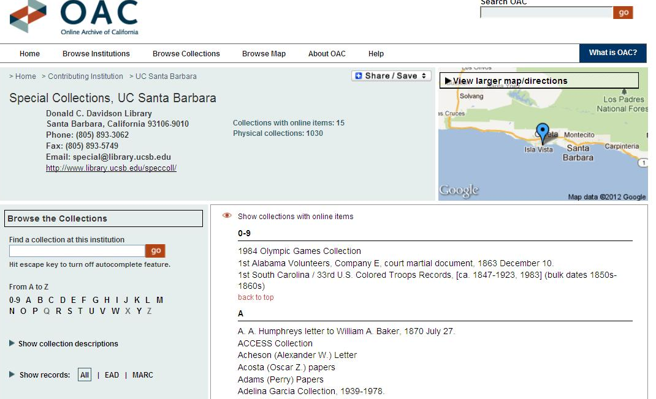
Digitization
Digitization can provide long term preservation and access.
Notes:
Digitizing collections of materials in all types of formats has become a top priority in many archives.
However, given the digital divide for some communities, traditional archiving may be more feasible.

Slide 14
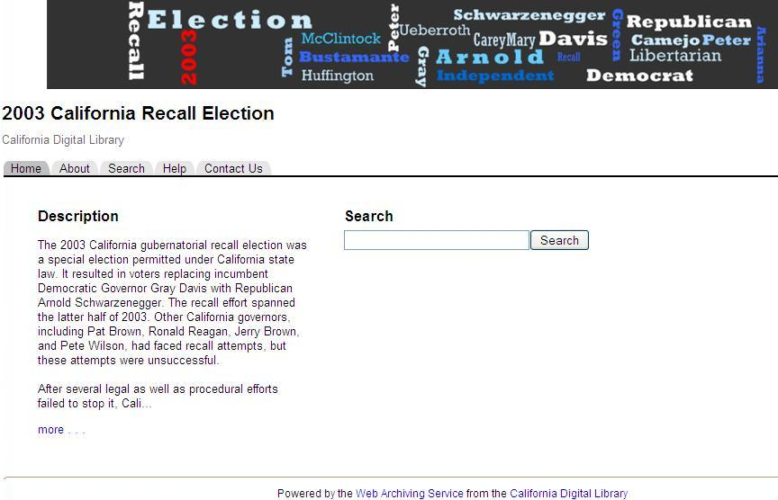
Web Archiving
Preserving websites
Notes:
Content from web pages must be maintained over time. Many websites are built for a period of time and then abandoned or removed entirely off the internet.
Web archiving tools were designed to archive, preserve and provide access to the content.

Slide 15
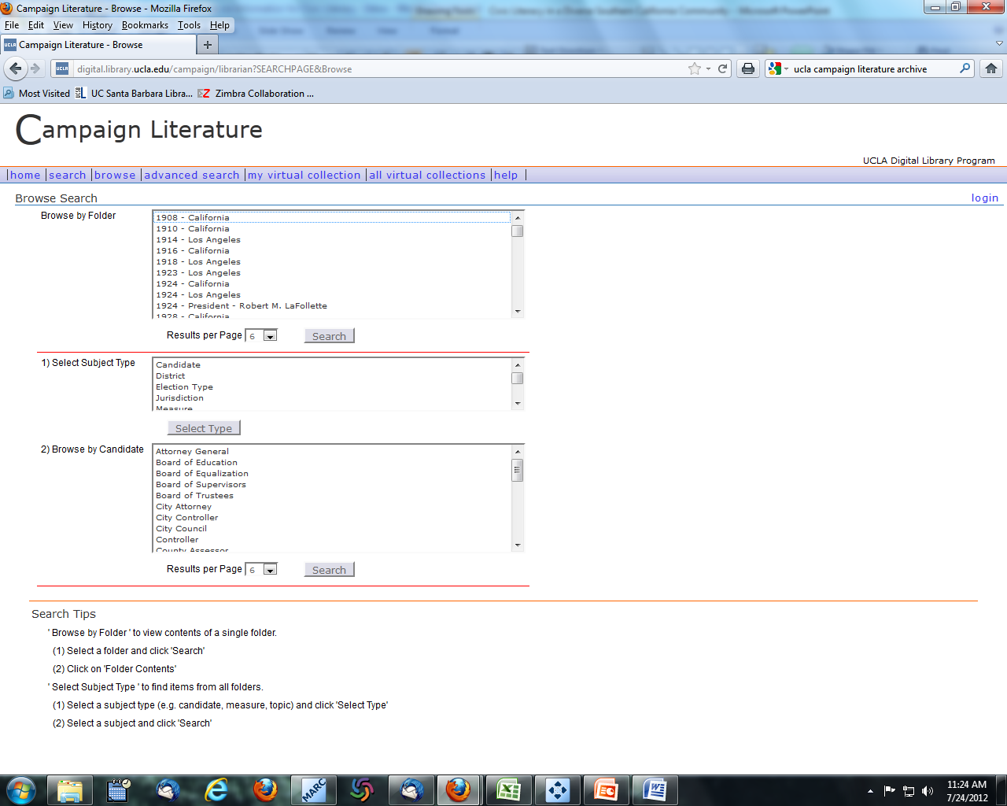
Campaign Literature – University of California, Los Angeles
Example of a University’s web archive of local elections and various political campaigns
Notes:
Some major concerns/issues include: lack of long term staffing and technical expertise; time; copyright concerns by owners of websites; preservation; maintenance, and costs.

Slide 16
Library Subject Guide – Local Government
-
Notes:
Whether creating online subject guides, like the example here; or providing printed brochures/ newsletters; or teaching library skills classes, as information professionals , we provide access to political information. This can help first time voters and our university community to participate in the civic process.

Slide 17
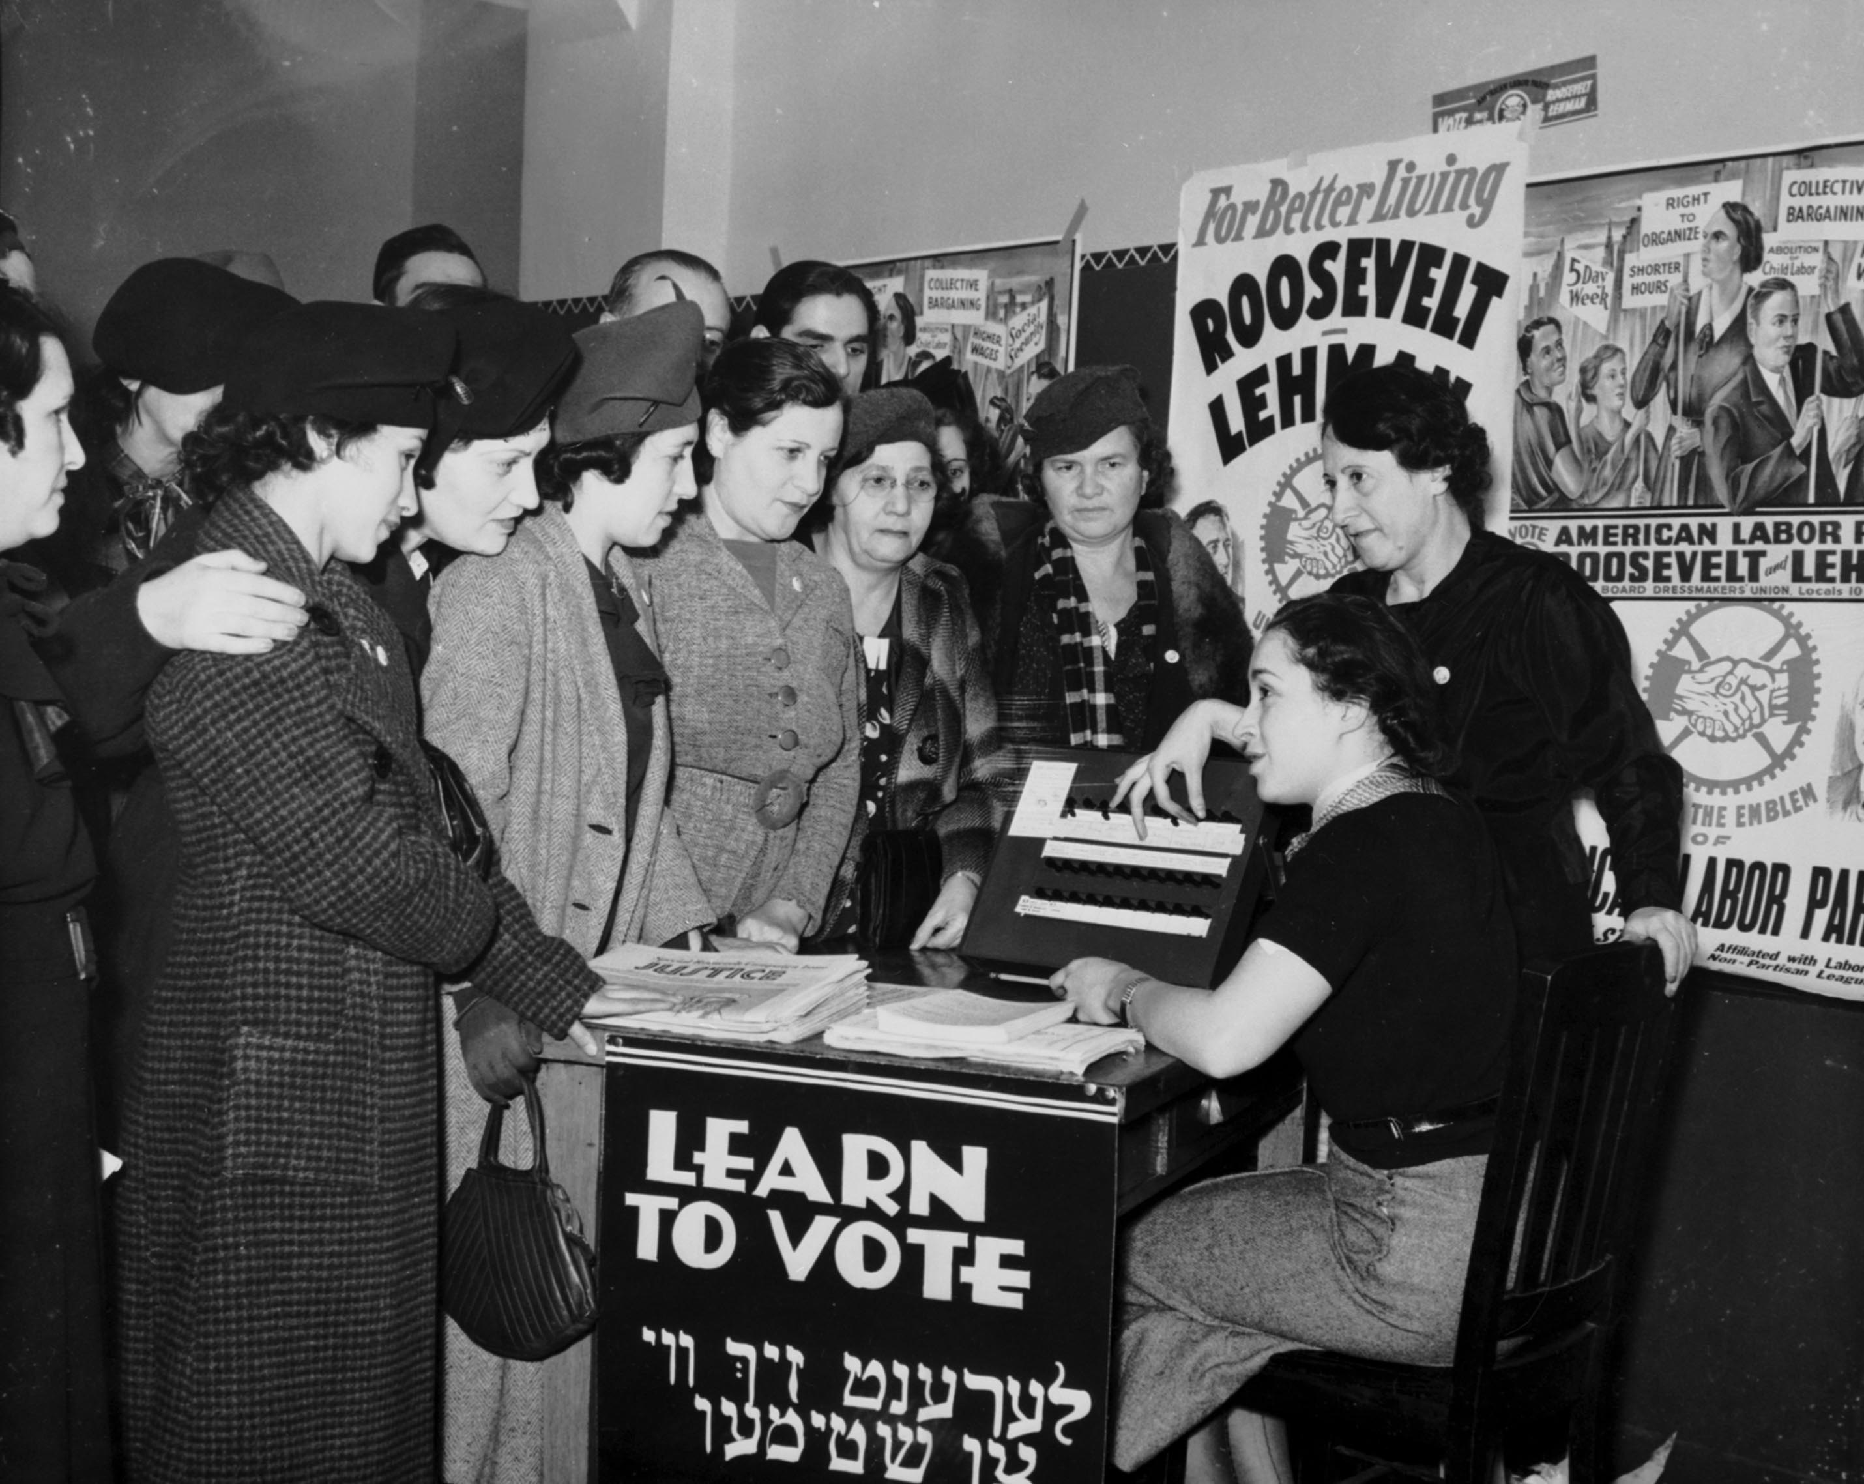
Other Pathways to Facilitate Civic Engagement
Advertise/Market Political Resources
- Provide Outreach services to communities
- Instruction
Community Outreach
Kheelcenter, “ Women voter outreach 1935 English and Yiddish” September 20, 2013 via Google, Creative Commons Attribution.
Notes:
Providing outreach services to our local community allows us to play a much greater role in facilitating civic engagement such as partnering with other community organizations.

Slide 18
Create neutral spaces for diverse group
Rockaway Township Library, “ English club First meeting Dover Library” September 24, 2013 via Google, Creative Commons Attribution.
Notes:
Creating neutral spaces for diverse community groups to have forums about social, economic, and political issues that impact their lives.
Here, is an example where participation could include learning about general elections, political candidates, voter election guides, etc.

Slide 19
Conclusion
“Elections come and go; but issues abide, as do our roles to promote information literacy and civic literacy” (Rettig 2008)
CHALLENGES
Staff limitations
Copyright
Financial support
Our goals, as Santa Barbara librarians, is to ensure that our community understand and have knowledge of past and present local issues.
In doing so, they will have the political information to create current and future coalitions to address concerns and fully participate in the civic process that impacts their lives.
-
Notes:
Despite some challenges that librarians may face in providing access to information in our communities, we continue in the belief (as Rettig notes)…
“elections come and go; but issues abide, as do our roles to promote information literacy and civic literacy”

Slide 20
References / Acknowledgements
Cooper, Lara.2009. “Longtime Santa Barbara Resident Issac Garrett Announces Mayoral Run.” Accessed August 4, 2013.
http://www.noozhawk.com/article/08100_isaac_garrett_announces_santa_barbara_mayoral_run
Clubb, Barbara. 2006. “Civic Literacy and Community Building.”Feliciter 52(1):4. Accessed April 30, 2012. http://www.cla.ca/AM/Template.cfm?Section=Vol_52_No_1&Template=/CM/ContentDisplay.cfm&ContentID=3837
Dahlen, Andrew.2009. “E-Democracy: The Internet and its effects on politics, Politicians, and the Policy-Making Process.”Accessed March 10, 2012. http://www.indiana.edu/~hightech/papers/Dahlen.htm
Kettmann, Matt. 2010. “ A Mosque Grows in Goleta: Inside the Islamic Society of Santa Barbara’s Quest to Build a Community Center”Santa Barbara Independent 24 no. 227 (May):31-35.
Kranich, Nancy.2005. “Civic Partnerships: The Role of Libraries in Promoting Civic Engagement”. Accessed April 10, 2012. http://www.nifi.org/news/news_detail.aspx?itemID=3856&catID=2871
Gray, Gabriella and Scott Martin. (2007). The UCLA Online Campaign Literature Archive: a Case Study. Accessed April 10, 2012, http://iwaw.europarchive.org/07/IWAW2007_gray.pdf
Online Archive of California. Accessed April 10, 2012. http://www.oac.cdlib.org/institutions/UC+Santa+Barbara::Special+Collections
Rettig, Jim.2008.”In Pursuit of Information.”American Libraries 39 no.11 (December).
Accessed March 30, 2012. http://jimrettig.org/content/columns/documents/December2008PDF.pdf
UCLA Online Campaign Literature Archive: A Century of Los Angeles Elections. Accessed April 10, 2012. http://digital.library.ucla.edu/campaign
University of California CDL California Digital Library Web Archiving Service (WAS). Accessed April 3, 2012. http://www.cdlib.org/services/uc3/was.html
University of California Santa Barbara. Accessed April 10, 2012. http://www.library.ucsb.edu/special-collections

